Slide 1

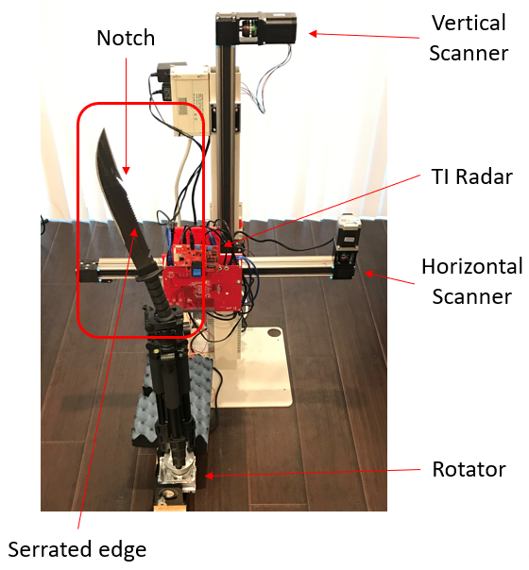
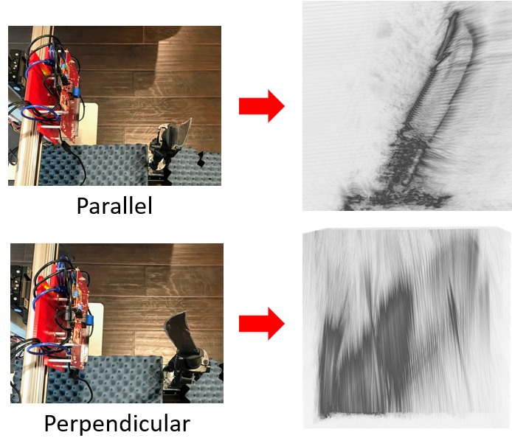
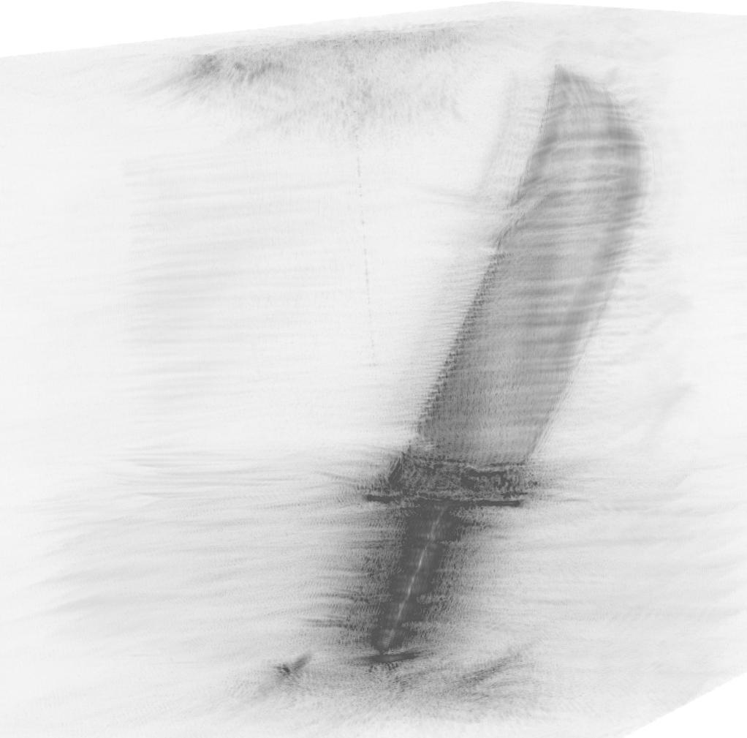
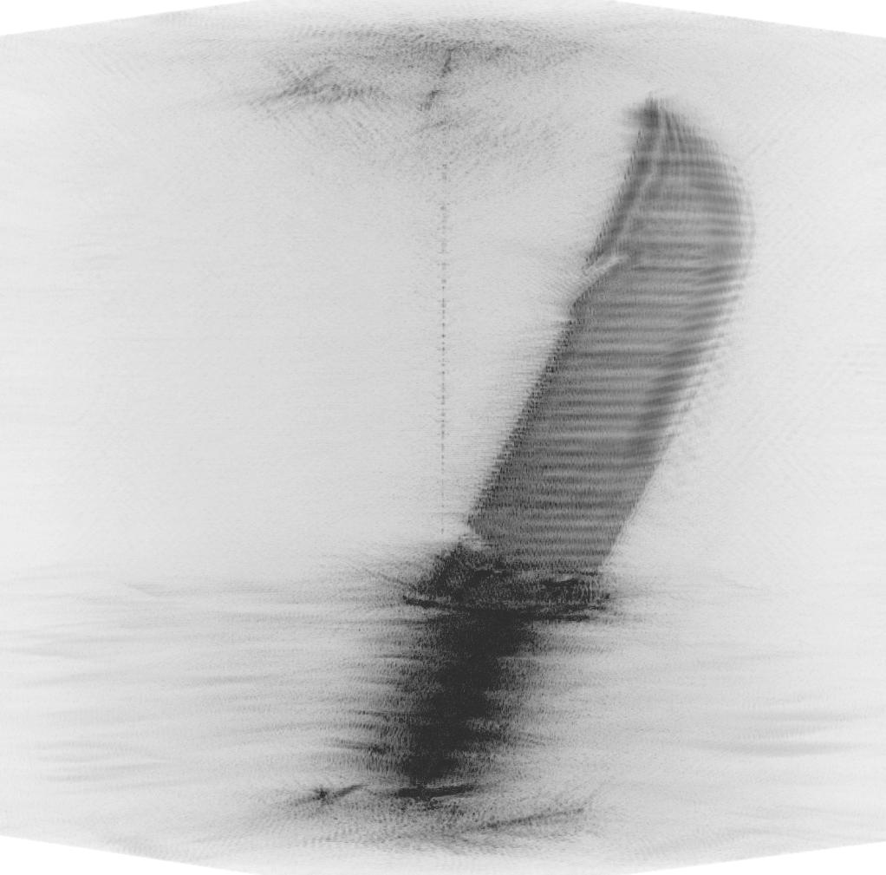
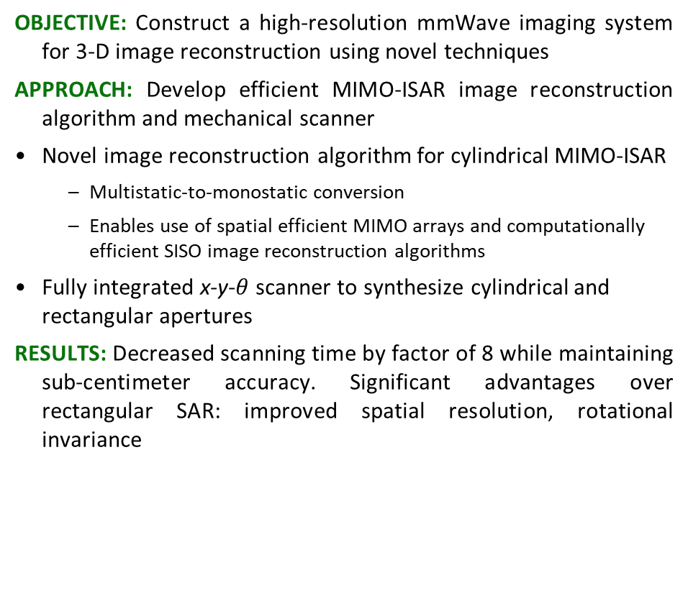
3-D Holographic Near-Field MIMO-ISAR Millimeter-Wave Imaging Josiah Smith, University of Texas at Dallas, TxACE
OBJECTIVE: Construct a high-resolution mmWave imaging system for 3-D image reconstruction using novel techniques
APPROACH: Develop efficient MIMO-ISAR image reconstruction algorithm and mechanical scanner
Novel image reconstruction algorithm for cylindrical MIMO-ISAR
Multistatic-to-monostatic conversion
Enables use of spatial efficient MIMO arrays and computationally efficient SISO image reconstruction algorithms
Fully integrated x-y-$θ$ scanner to synthesize cylindrical and rectangular apertures
RESULTS: Decreased scanning time by factor of 8 while maintaining sub-centimeter accuracy. Significant advantages over rectangular SAR: improved spatial resolution, rotational invariance
SISO – 137min
MIMO – 17 min

Slide 3
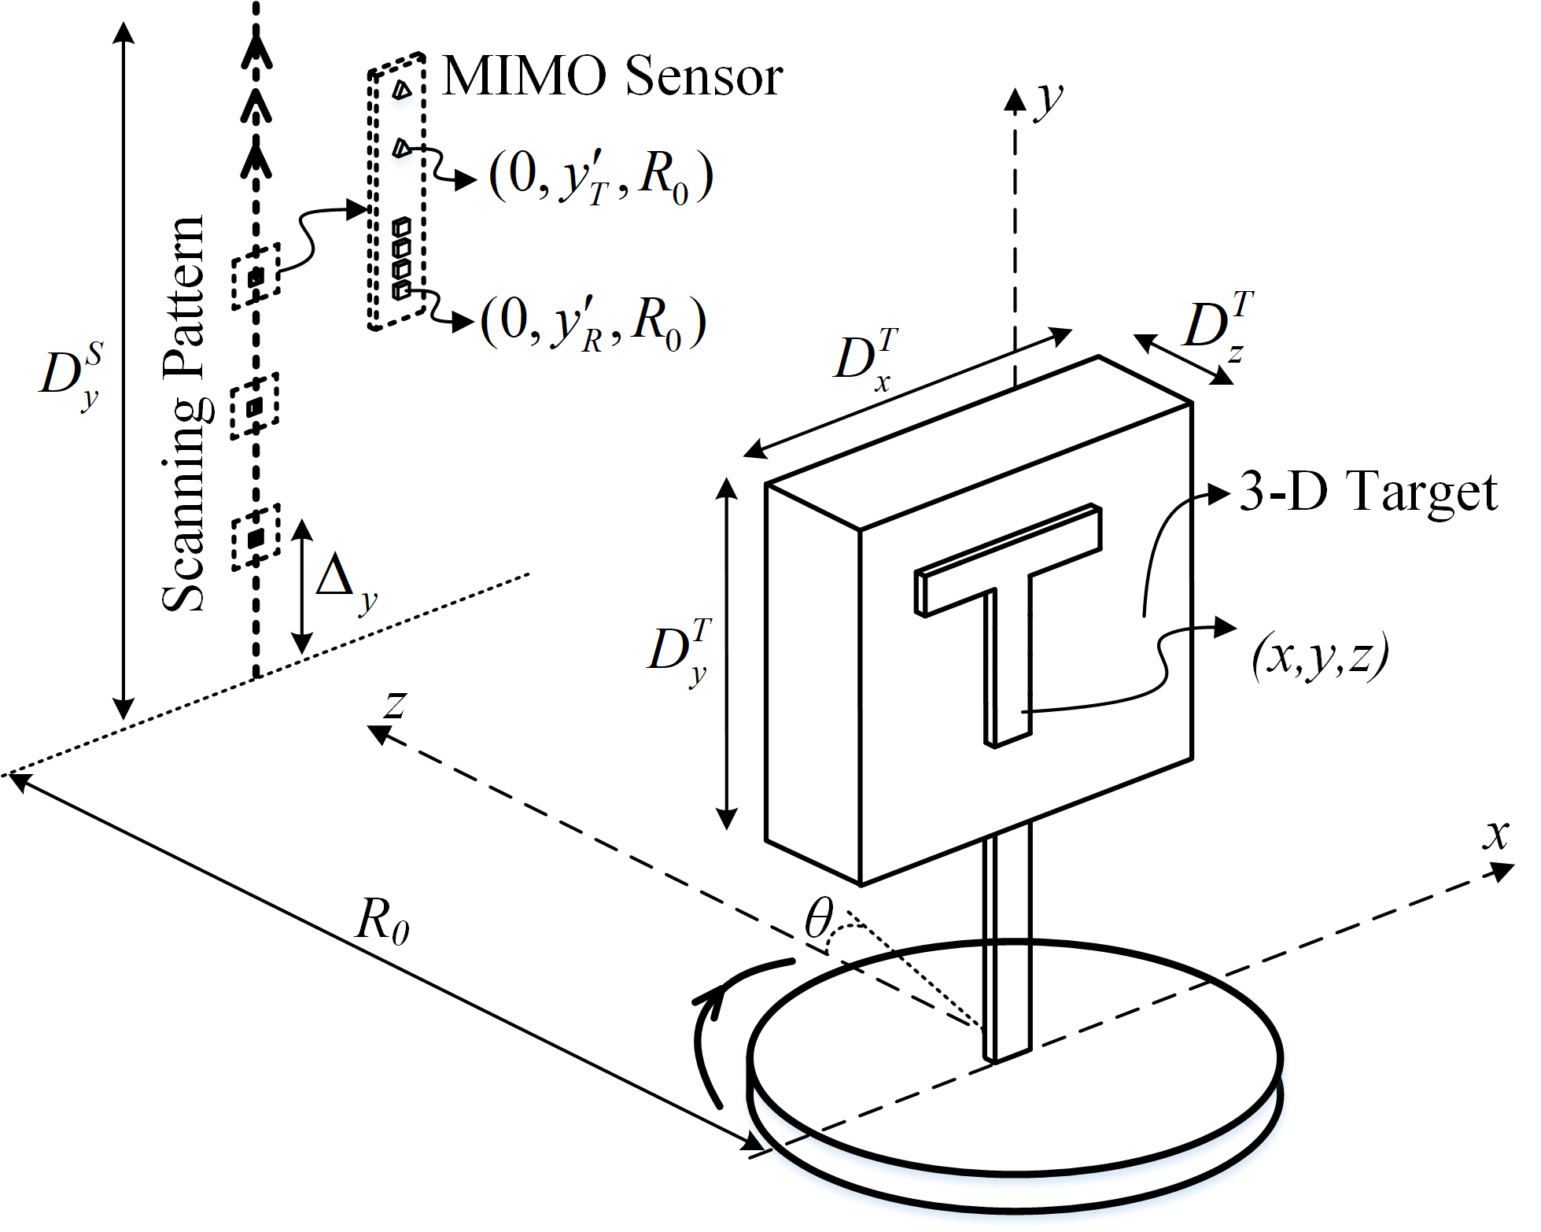
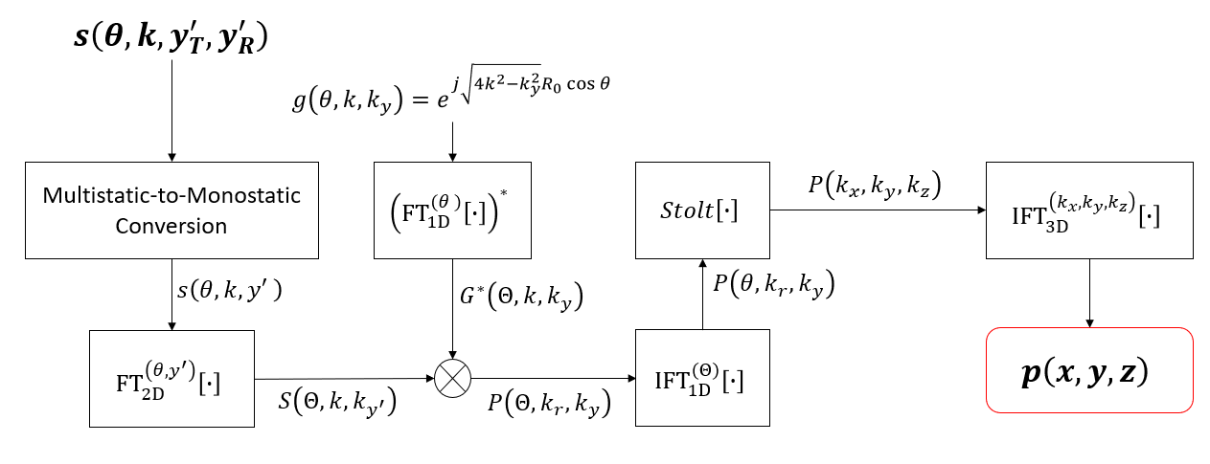
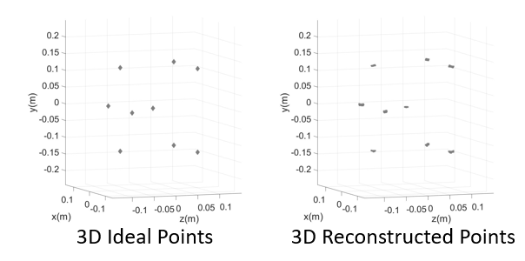

3-D Holographic Near-Field MIMO-ISAR Millimeter-Wave Imaging Josiah Smith, University of Texas at Dallas, TxACE
OBJECTIVE: Construct a high-resolution mmWave imaging system for 3-D image reconstruction using novel techniques
APPROACH: Develop efficient MIMO-ISAR image reconstruction algorithm and mechanical scanner
Novel image reconstruction algorithm for cylindrical MIMO-ISAR
Multistatic-to-monostatic conversion
Enables use of spatial efficient MIMO arrays and computationally efficient SISO image reconstruction algorithms
Fully integrated x-y-$θ$ scanner to synthesize cylindrical and rectangular apertures
RESULTS: Decreased scanning time by factor of 8 while maintaining sub-centimeter accuracy. Significant advantages over rectangular SAR: improved spatial resolution, rotational invariance

Slide 4
3-D Holographic Near-Field MIMO-ISAR Millimeter-Wave Imaging Josiah Smith, University of Texas at Dallas, TxACE
OBJECTIVE: Construct a high-resolution mmWave imaging system for 3-D image reconstruction using novel techniques
APPROACH: Develop efficient MIMO-ISAR image reconstruction algorithm and mechanical scanner
Novel image reconstruction algorithm for cylindrical MIMO-ISAR
Multistatic-to-monostatic conversion
Enables use of spatial efficient MIMO arrays and computationally efficient SISO image reconstruction algorithms
Fully integrated x-y-$θ$ scanner to synthesize cylindrical and rectangular apertures
RESULTS: Decreased scanning time by factor of 8 while maintaining sub-centimeter accuracy. Significant advantages over rectangular SAR: improved spatial resolution, rotational invariance

Slide 5
3-D Holographic Near-Field MIMO-ISAR Millimeter-Wave Imaging Josiah Smith, University of Texas at Dallas, TxACE
OBJECTIVE: Construct a high-resolution mmWave imaging system for 3-D image reconstruction using novel techniques
APPROACH: Develop efficient MIMO-ISAR image reconstruction algorithm and mechanical scanner
Novel image reconstruction algorithm for cylindrical MIMO-ISAR
Multistatic-to-monostatic conversion
Enables use of spatial efficient MIMO arrays and computationally efficient SISO image reconstruction algorithms
Fully integrated x-y-$θ$ scanner to synthesize cylindrical and rectangular apertures
RESULTS: Decreased scanning time by factor of 8 while maintaining sub-centimeter accuracy. Significant advantages over rectangular SAR: improved spatial resolution, rotational invariance
SISO – 137min
MIMO – 17 min

Slide 6
3-D Holographic Near-Field MIMO-ISAR Millimeter-Wave Imaging Josiah Smith, University of Texas at Dallas, TxACE
OBJECTIVE: Construct a high-resolution mmWave imaging system for 3-D image reconstruction using novel techniques
APPROACH: Develop efficient MIMO-ISAR image reconstruction algorithm and mechanical scanner
Novel image reconstruction algorithm for cylindrical MIMO-ISAR
Multistatic-to-monostatic conversion
Enables use of spatial efficient MIMO arrays and computationally efficient SISO image reconstruction algorithms
Fully integrated x-y-$θ$ scanner to synthesize cylindrical and rectangular apertures
RESULTS: Decreased scanning time by factor of 8 while maintaining sub-centimeter accuracy. Significant advantages over rectangular SAR: improved spatial resolution, rotational invariance
SISO – 137min
MIMO – 17 min

Slide 7
3-D Holographic Near-Field MIMO-ISAR Millimeter-Wave Imaging Josiah Smith, University of Texas at Dallas, TxACE
OBJECTIVE: Construct a high-resolution mmWave imaging system for 3-D image reconstruction using novel techniques
APPROACH: Develop efficient MIMO-ISAR image reconstruction algorithm and mechanical scanner
Novel image reconstruction algorithm for cylindrical MIMO-ISAR
Multistatic-to-monostatic conversion
Enables use of spatial efficient MIMO arrays and computationally efficient SISO image reconstruction algorithms
Fully integrated x-y-$θ$ scanner to synthesize cylindrical and rectangular apertures
RESULTS: Decreased scanning time by factor of 8 while maintaining sub-centimeter accuracy. Significant advantages over rectangular SAR: improved spatial resolution, rotational invariance
SISO – 137min
MIMO – 17 min

